Slide 1
New Calendar: March
Thurs, March 14th – Ch. 17 Economic Policymaking
Monday, March, 18th - Ch. 18
Wednesday, March 20th – Ch. 19
Thursday, March 21st – Ch. 20
Public Policy and Court Cases Exam: Tuesday, April 2

Slide 2
Public POlicy
68 days… OMG
Unit 7

Slide 3
What does College Board say about Public Policy?

Slide 4
Defining Public POlicy

Slide 5
Objective
In groups, students will be able to demonstrate their understanding of the the process and related key terms for a specific realm of policymaking by discussing and creating a 45 minute lesson to teach to the class. The lesson will include a reading discussion, engaging activity, and a graded assessment.

Slide 6
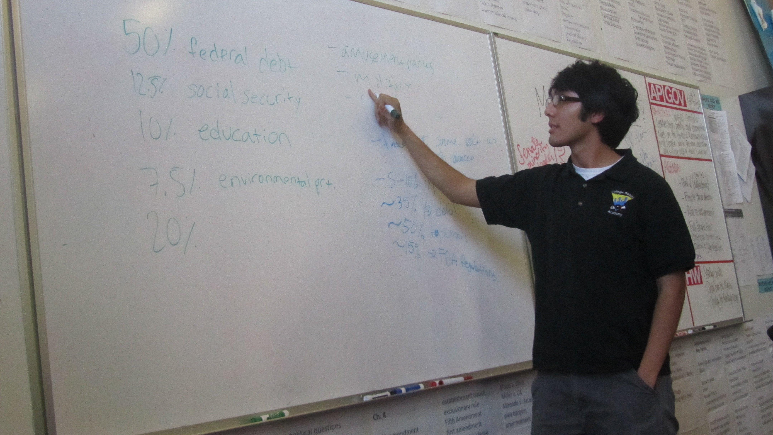
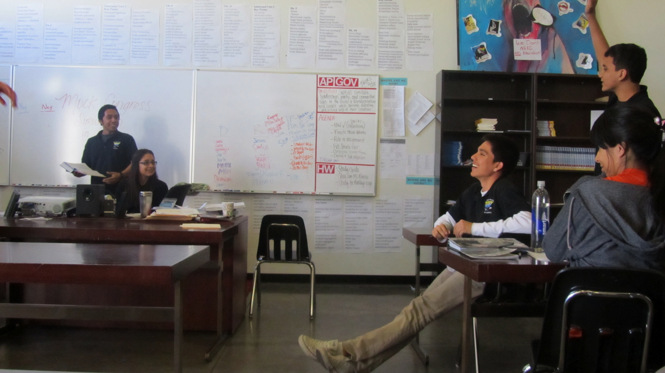
You are the TeacherS
What should you be doing?
Everyone else in the room (including Mrs. Tsai) are the students. What will you expect of your students?

Slide 7
Materials
Reading notes
Relevant charts and graphs
Crash Course or 5 Steps
2 laptops per group (During group discussion, to be used only for clarification of reading material and recording key discussion points. Will be used mostly during planning.)

Slide 8
Structured Group Chapter Discussion
Sugg. Time: 20—30 mins
Suggested Presentation Time for Rdg. Discussion: 15-20 mins
Roles:
Discussion Facilitator
Time Keeper (could be same as Facilitator)
Key Terms Tracker
Participation Tabulator
Group Tasks (Should look like a mini-Socratic):
Review reading
State your arguments and justify your reasoning
Ask clarifying questions
Create questions to check for each other’s understanding
Analyze charts and graphs
Notes:
Facilitator: make sure conversations keep going and the group is doing the tasks
Time Keeper: keep group on task and moving through activities on time
Key Terms Tracker: generates list of bold and other essential key terms for the chapter. Ensures that each group member understands the terms discussed.
Participant Tabulator: tracks and holds everyone accountable to equitable participation

Slide 9
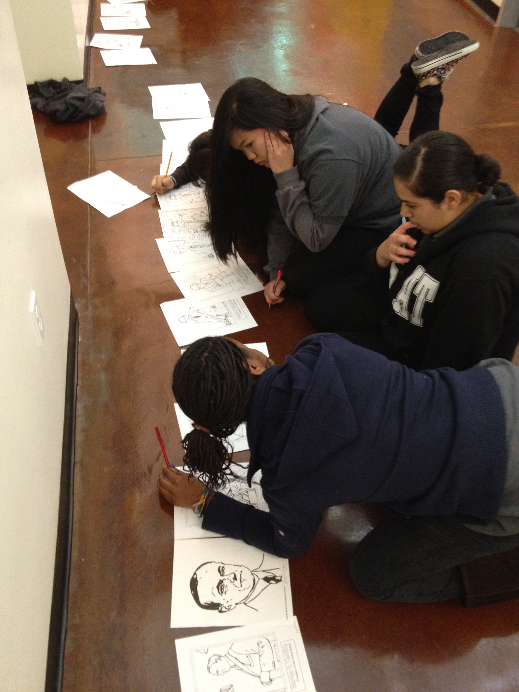
Activity Creation
Sugg. Planning Time: 30-40 mins
Sugg. Presentation Activity Time: 10-30 mins
Don’t forget to type up instructions, rules, handouts, etc.
Notes:
Gallery walk
Debate
Poster or project creation
Simulation

Slide 10
Assessment Creation
Sugg. Planning Time: 20-30 mins
Sugg. Presentation Assessment Time: 5-25 mins
MC Quiz
Fill in the blank key terms quiz
FRQ (you make up or get from College Board)
* All assessments must have answer key turned in to Mrs. Tsai. Assessments will be graded at the end of your presentation.
Notes:
MC Quiz
Fill in the blank key terms quiz
FRQ (you make up or get from College Board)

Slide 11
RUBRIC
In your email inboxes ☺

Slide 12
Re-Cap, HW, & Preparation for Next Week
Defining Public Policy
Expectations for Presentations
HW: Prepare presentations and re-do Unit 6 Portfolio work
Metacognition: More sheets available. Due Thursday!
Monday: Congress re-teaching
CAHSEE days: Read Ch. 17 (or 18) and prepare for presentations

